Slide 1
SLURP
You crave it, you have it
Under the guidance of Presented by
Vishal Chawla Deepak Chandwani
Naman Bhargava
Nitin Prince Reuben
Raghavi Kirouchenaradjou

Slide 2

Index
Background
Our Solution
Strategic plane
Scope plane
Structure plane
Skeleton plane
Surface plane
Information Architecture
Workflows
UX Research Methods
Human Computer Interaction
Moonshot ideas
Demo
QA Testing – Selenium
Reflections

Slide 3
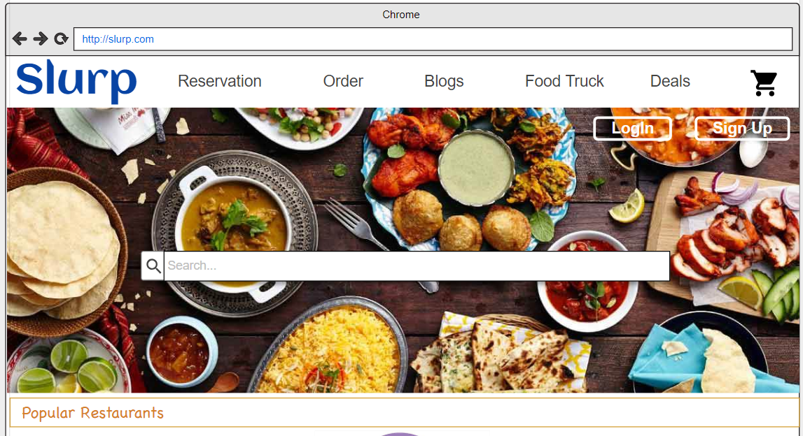
Background
Slurp is the go-to site for diners looking to discover great places to eat
It’s a website using which we can
Order Food
Search Restaurants Online
Reserve a table in a restaurant
Details of trending Food trucks
Different business to collaborate with us
Get deals on food

Slide 4
Our Solution
Ability to filter searches according to restaurants’ neighborhood, cuisine type, price, busy hours and nearby locations
Collection of thousands of restaurant menus that are regularly updated, along with reviews and recommendations from its community of users
Allows users to follow their favorite food bloggers/critic
Allows registered users to participate in any events [Food Festival]
They can view the restaurant updates menus and can perform online food ordering
It also allows users to integrate their account with other social media accounts like Instagram, Facebook, Snapchat, Twitter, etc
Users will be notified if the item/dish he wants is available or not
People can get rewards in the form of coupons . Ex: Top 10 bloggers could be rewarded with coupon codes or any deals in the restaurant of their choice

Slide 5
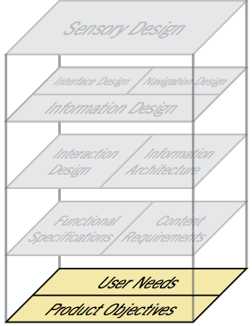
Strategic Plane
USER NEEDS
Place where the user can find the perfect restaurant available in their town/city and perfect meal for everyday craving
PRODUCT OBJECTIVE
A platform for every food requirements
It also gives healthy food tips
BRAND-IDENTITY
A User Centered
Like the logo – we care about people for their health

Slide 6
USER SEGMENTATION
Customer Segmentation
People who don’t want to cook and who want to eat outside
People who want food to be delivered at their door step
Demographics
Age groups (above 15 years up to 65 years)
Income
Gender
Family Size
Interests
Bloggers
Foodies
Tech Savvy

Slide 7
USER SEGMENTATION
Restaurants
Which do not have delivery guys
Those which do not take online orders
Who wants to make use of our app

Slide 8

User Persona
Katelyn Pierce , 28 – Single, Tech-Savvy, Foodie, lives in Seattle
She is a senior at the University of Washington, she is studying Information Systems and is living with three roommates near University Village. She loves going out with friends and exploring Seattle and is always looking for new restaurants to dine with friends
When she invites friends out to dinner, she frequently takes charge in finding a restaurant that matches everyone’s needs
Desires :
She wants to quickly share link/s
She needs to find new restaurants easily
She needs to recognize and be able to go back and forth between restaurants when contemplating
Feedback:
She felt this application is very useful and easy to use
Sharing information with friends is easy
It helps you to choose food according to your mood and also shares lots of information about it

Slide 9

USER PERSONA
Brinda Geller , 42 – working mother living with her husband and 2 daughters in Boston, MA
She is working as a Nurse at Boston Children’s Hospital
Average Comfort with Technology
Not Savvy with latest tools
Desires :
One website from which you can order food or look for restaurants
Different food options
Feedback:
She felt this application is very useful and easy to use
Food truck option excites her

Slide 10
SUCCESS METRICS
Increase in traffic : This is the most important metrics which enables mostly everything that comes after it
User Engagement : Tracking visits and signups is important, but we focus more on how long a user spends on our website than just how many people simply came to our website
Repeat user: No matter how many users your site may have, the real proof of success is having those users come back
Referrals from current clients: it means that we’re doing a great job delivering and keeping our customers happy enough to spread the word
Clicks from social platforms: The data can be used as an extension to the analytics platform and can provide extra insights

Slide 11
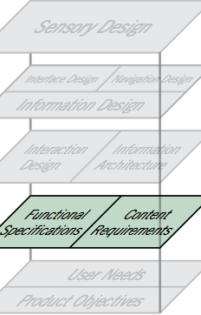
Scope Plane
Functional Requirements
Filters: Browse of menu of different restaurants
GPS Tracking: Track your order
Communication: Chat with restaurant owner/delivery personal
Live Booking: Reserve a table
Phone notifications: Notification of news blogs and events
Sign Up: New user can sign up
Onboarding: Email notification when you sign up with a onboarding video
Business: New restaurants can also sign up to get featured in our website

Slide 12
Content Requirements
Business Info: Details of restaurants and menus that have registered with Slurp
Blogs & Reviews: Valid contents regarding various topics about health and reviews of different restaurants
User signup: Details of each user signed up on Slurp
Feeds: Top and trending restaurants
Google maps: Details of food trucks
FAQ: General Questions and answers relating to the usage policies of Slurp

Slide 13
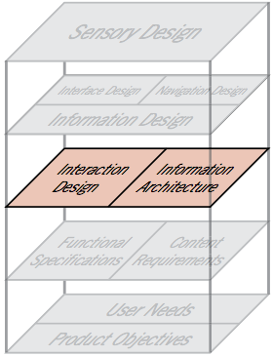
Structure Plane
Interaction Design
The app provides add to cart feature where in you can see items “fly” into your cart as soon as add to cart button is clicked
The tour option is always available for users to get familiar with all the features and power of the website
The options in the webpages are consistent with all specific features

Slide 14
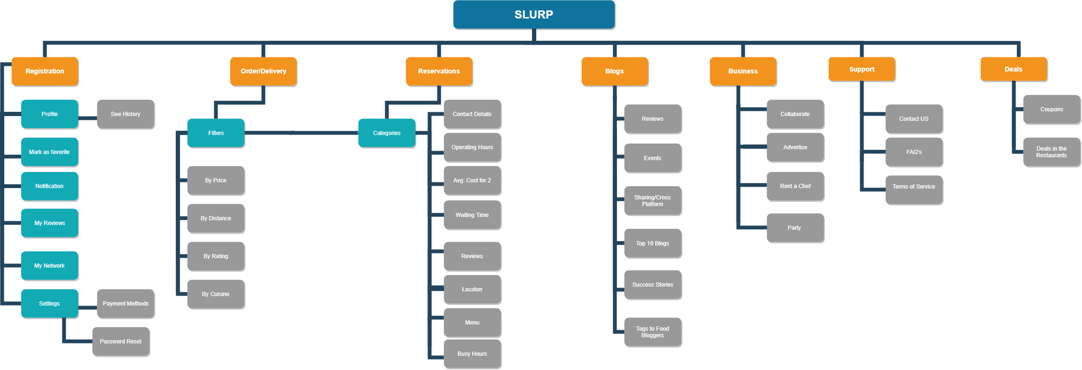
Information Architecture

Slide 15
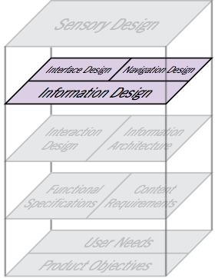
Skeleton Plane
Defining the skeleton
Interface design — the familiar realm of buttons, fields, and other interface components
Navigation design — the specialized form of interface design tailored to presenting information spaces
Information design — the presentation of information for effective communication

Slide 16
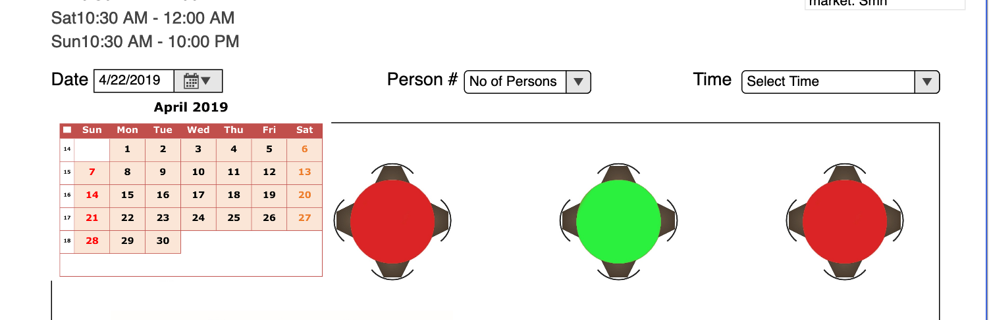
INTERFACE DESIGN
The interface of the webpages has been designed to let users notice important features of the app
The design helps users to accomplish the task by selecting right interfaces

Slide 17
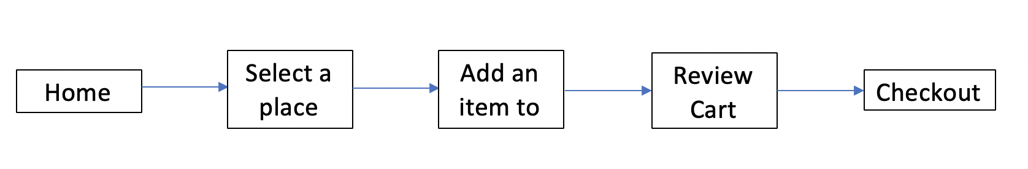
NAVIGATION DESIGN
Providing the navigation to flow through the information spaces to accomplish the task of the user

Slide 18
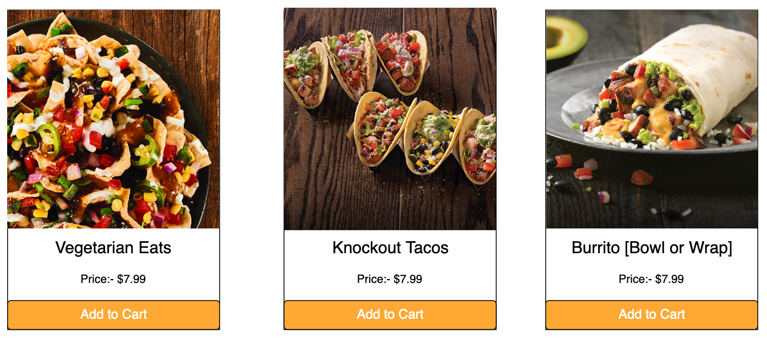
INFORMAITON DESIGN
The color coding, icons and labels used are conventional and are efficient for wayfinding

Slide 19
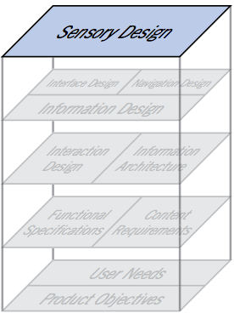
Surface Plane
Consistency
The website follows same recurring design patterns throughout
Contrast
The colors and contrast used are standard and doesn't look sore to the eyes when a user navigates through different pages of the website

Slide 20
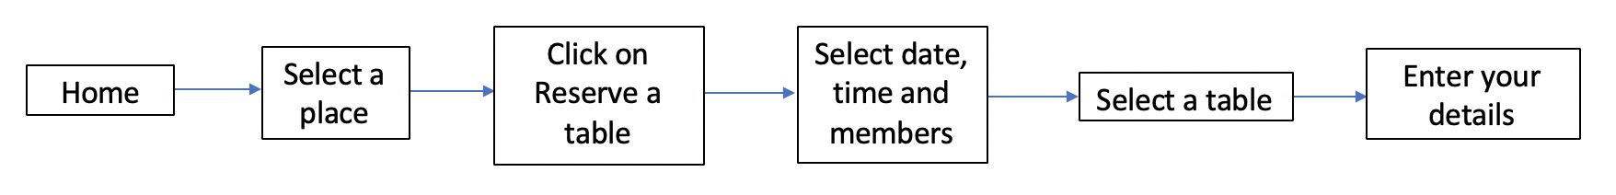
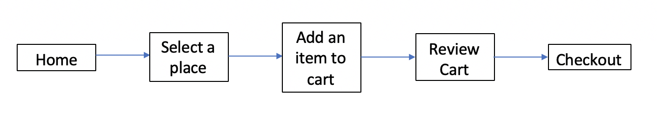
Workflow
Reserve a table
Order Food

Slide 21
UX Methods
Behavioral
Usability Testing
User Feedback
Card Sorting
Survey
Attitudinal
Qualitative
Quantitative

Slide 22
Usability testing
Sign up to the website
Order food through ‘order’ feature
Book a table through reservation
Y | Y | Y | Y | Y
17s | 28s Sign up using form | 38s Sign up using form | 20s | 16s
Y | Y | Y | Y | Y
9s | 14s | 32s Person had to navigate to cart again and again to review order | 11s | 15s
Y | Y | Y | Y | Y
15s | 14s | 16s | 15s | 17s

Slide 23
Read favorite food bloggers blog
Ask a question using chatbot
Y | N | Y | Y | Y
3s | 12s Person was expecting a search field | 4s | 2s | 4s
Y | N | Y | Y | Y
3s | Person didn’t explore the website | 5s | 6s | 5s

Slide 24
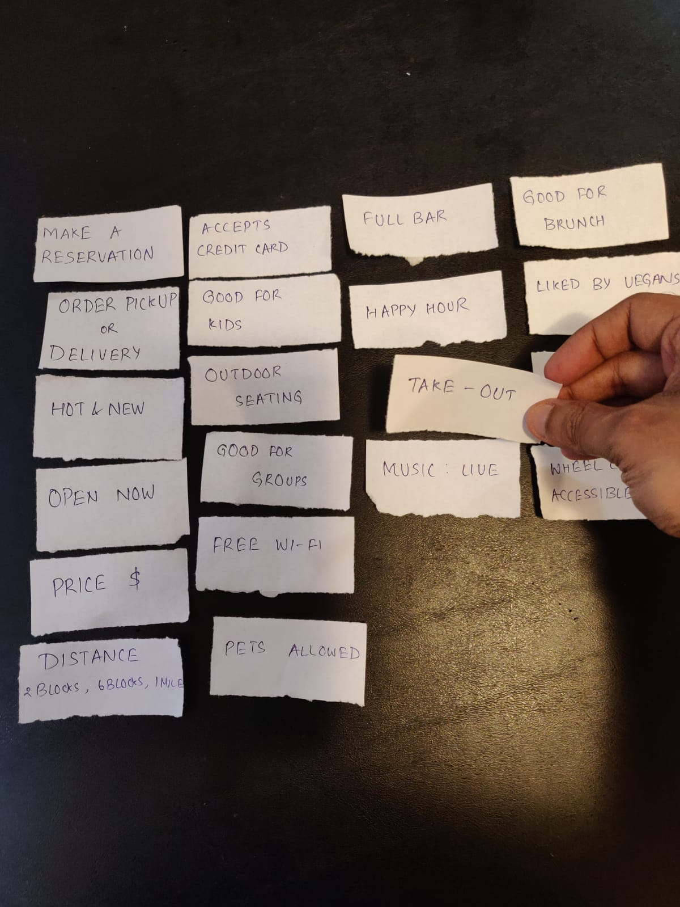
Card Sorting
We conducted card sorting to understand visual hierarchy for filter menu in slurp. By using card sort we reduced the options to around 60%
We asked participants to arrange cards according to their preference and remove options which they seem irrelevant

Slide 25
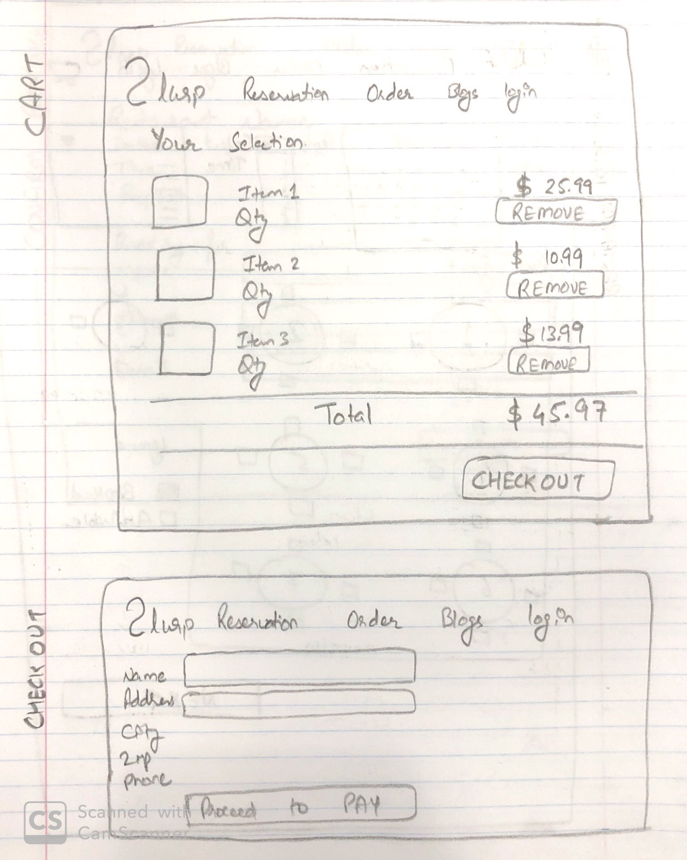
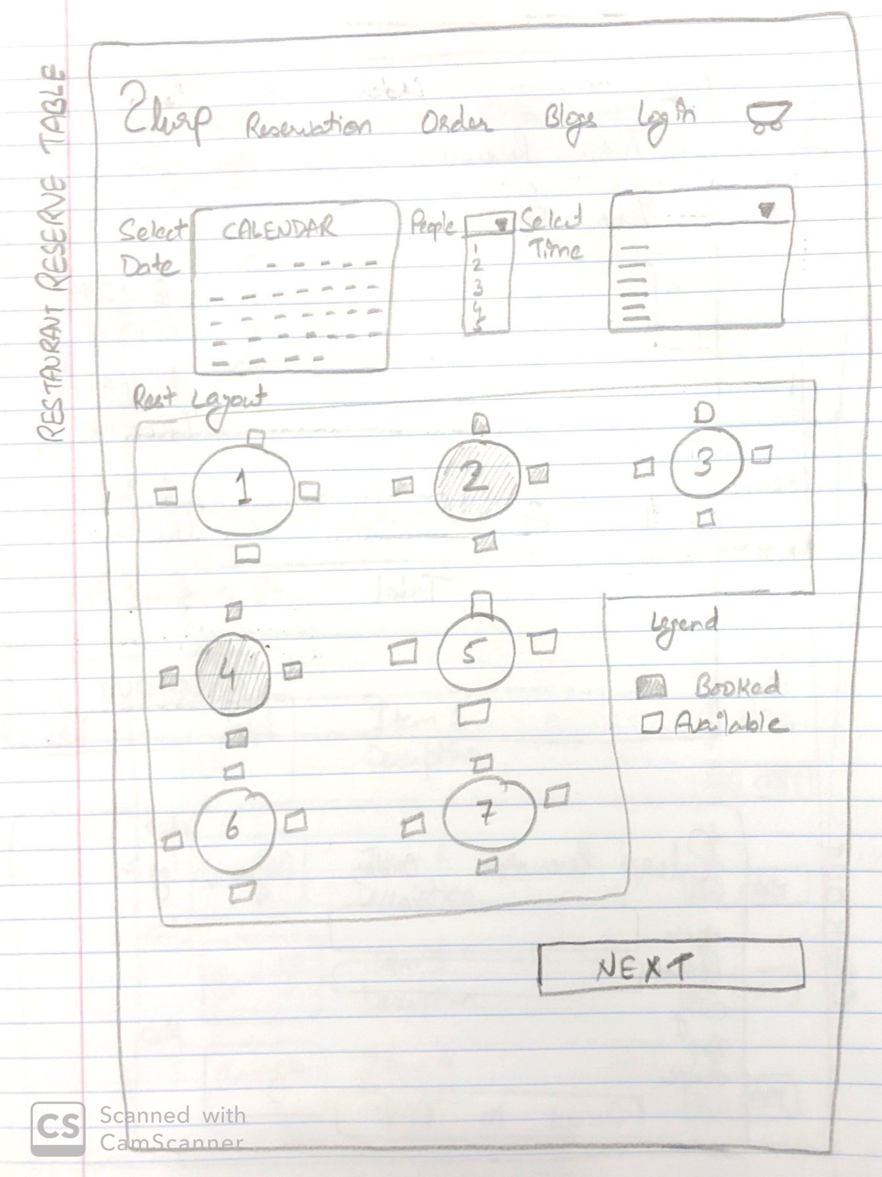
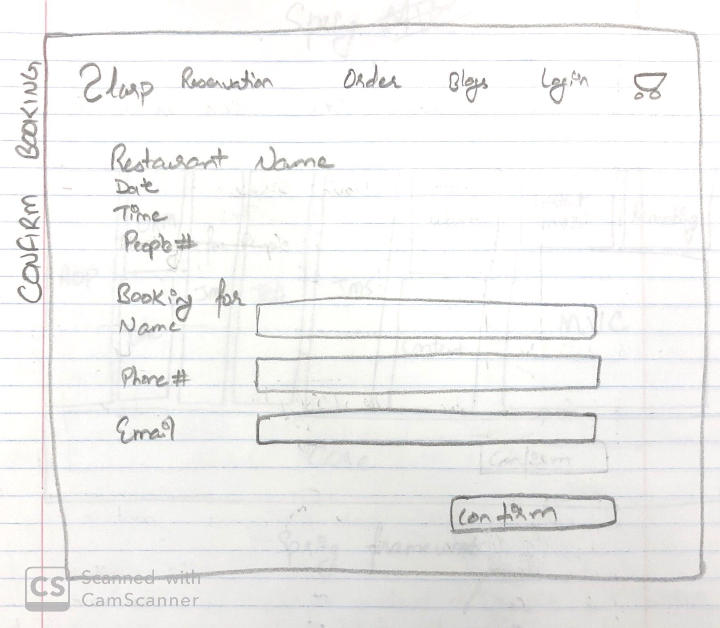
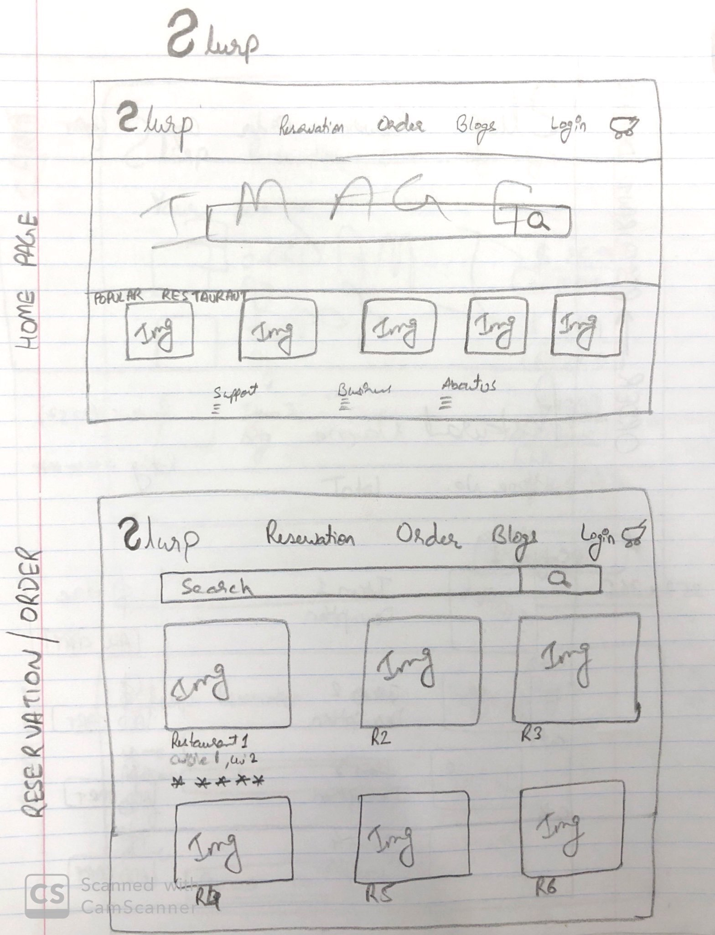

Slide 26


PROTOTYPE

Slide 27

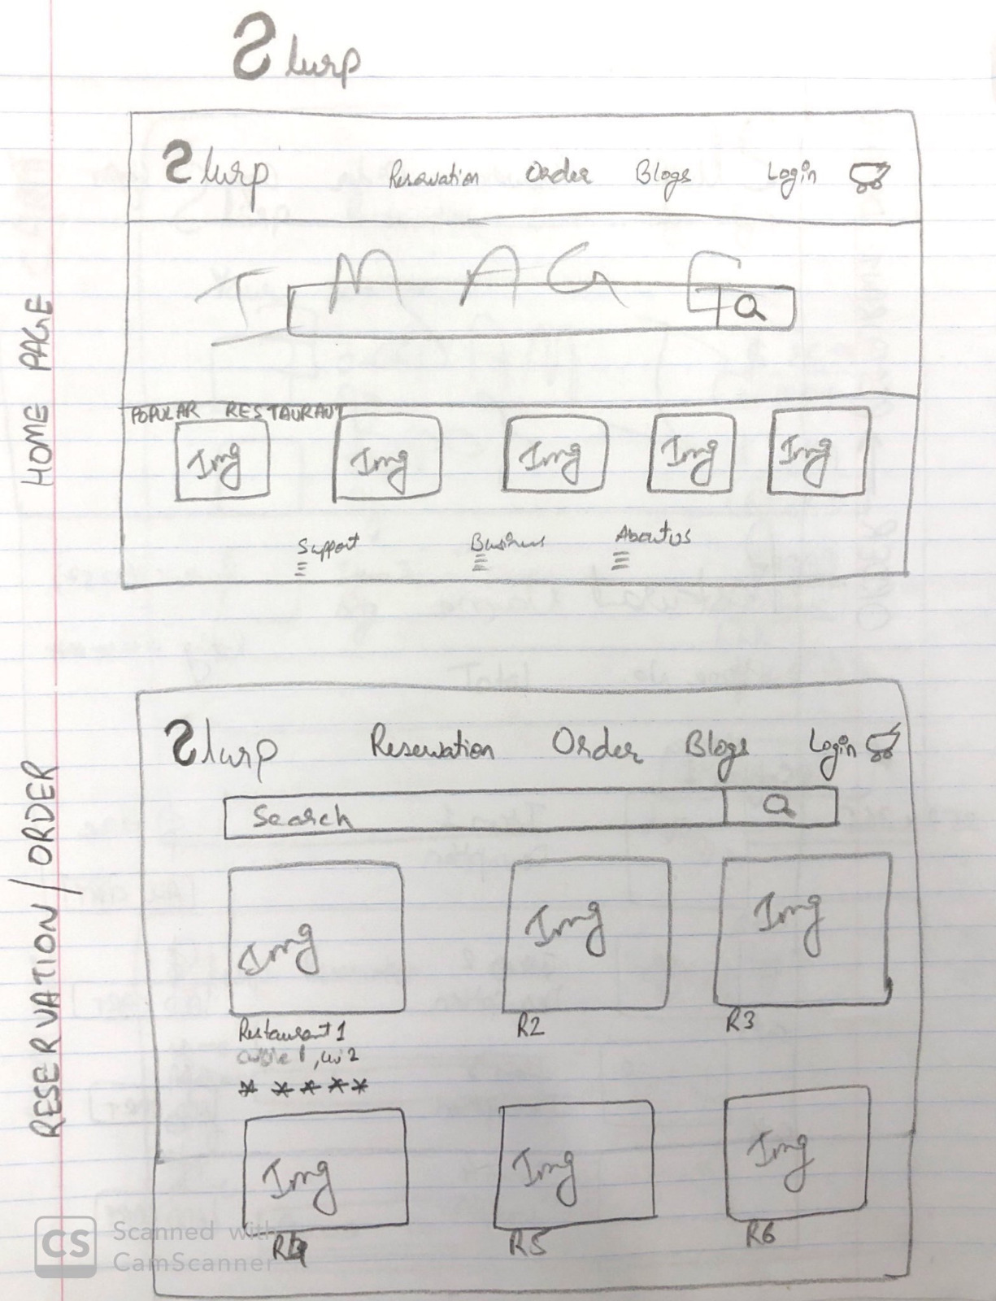

Slide 28
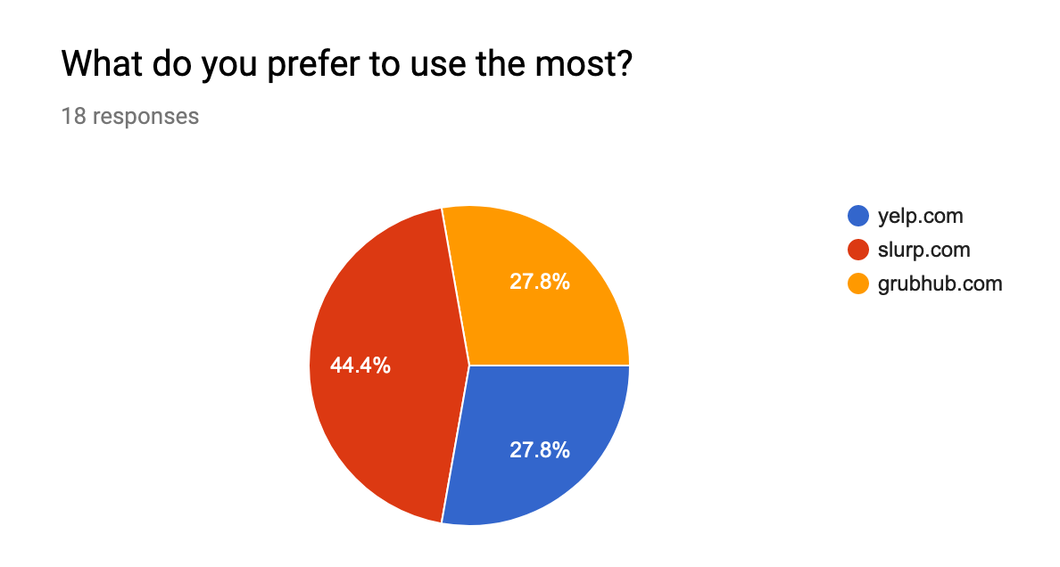
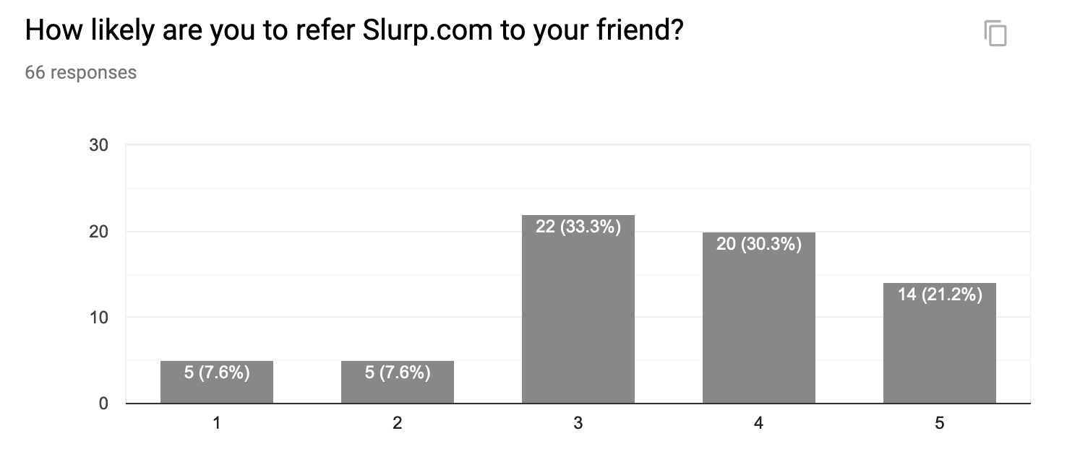
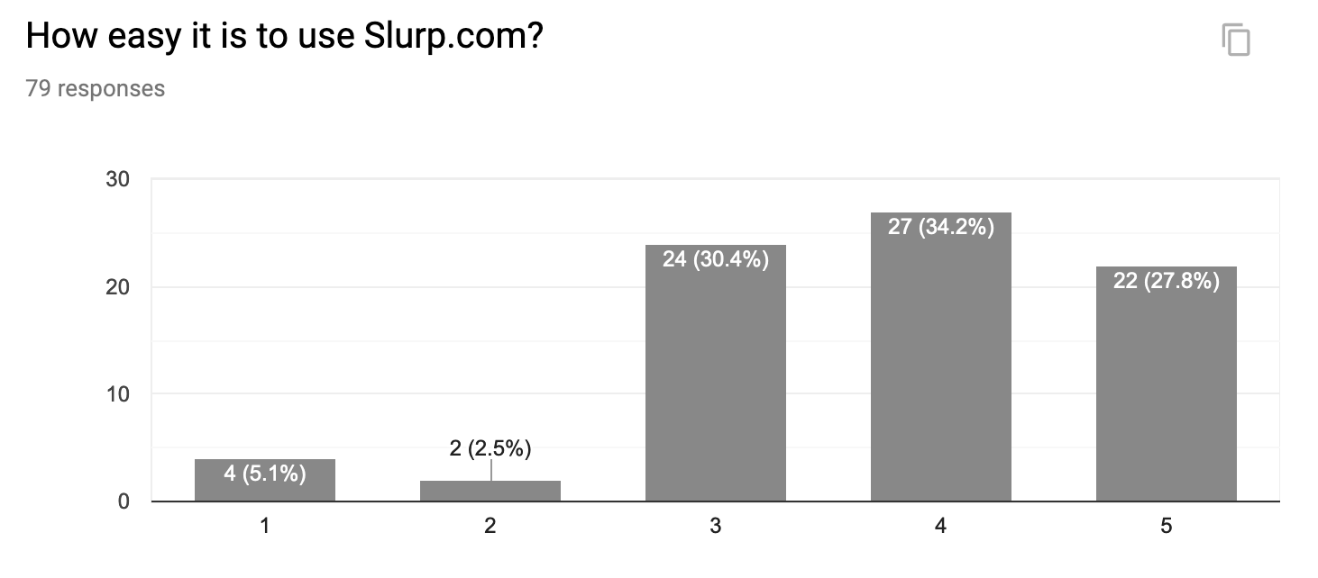
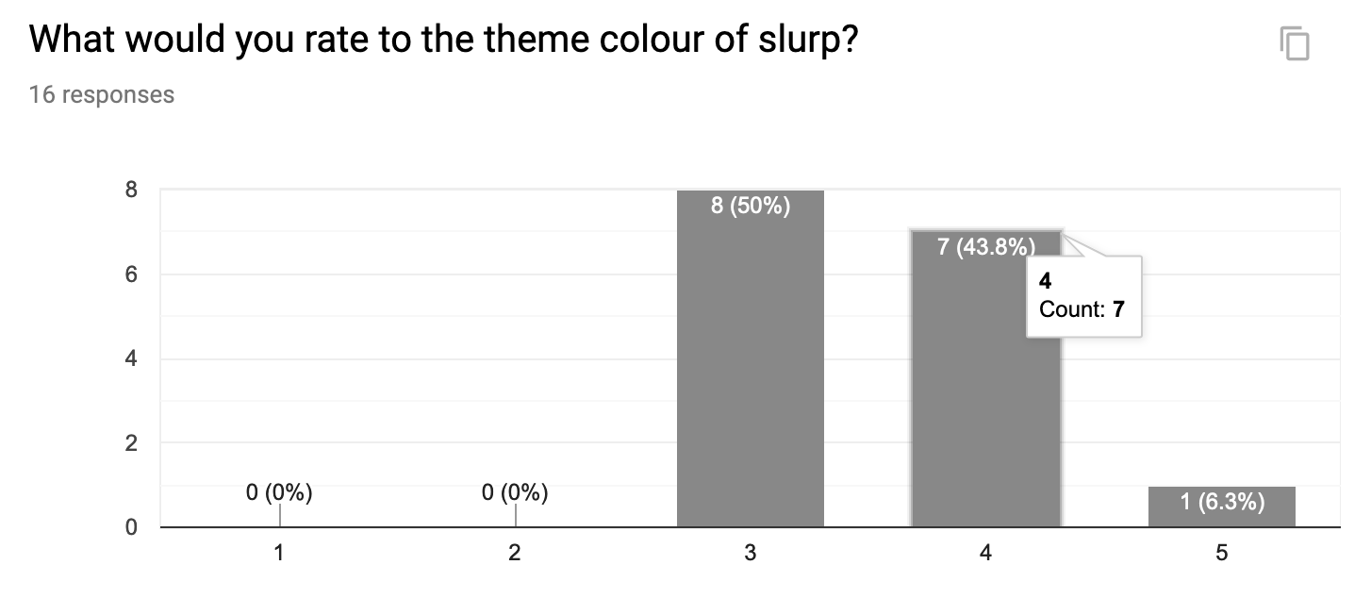
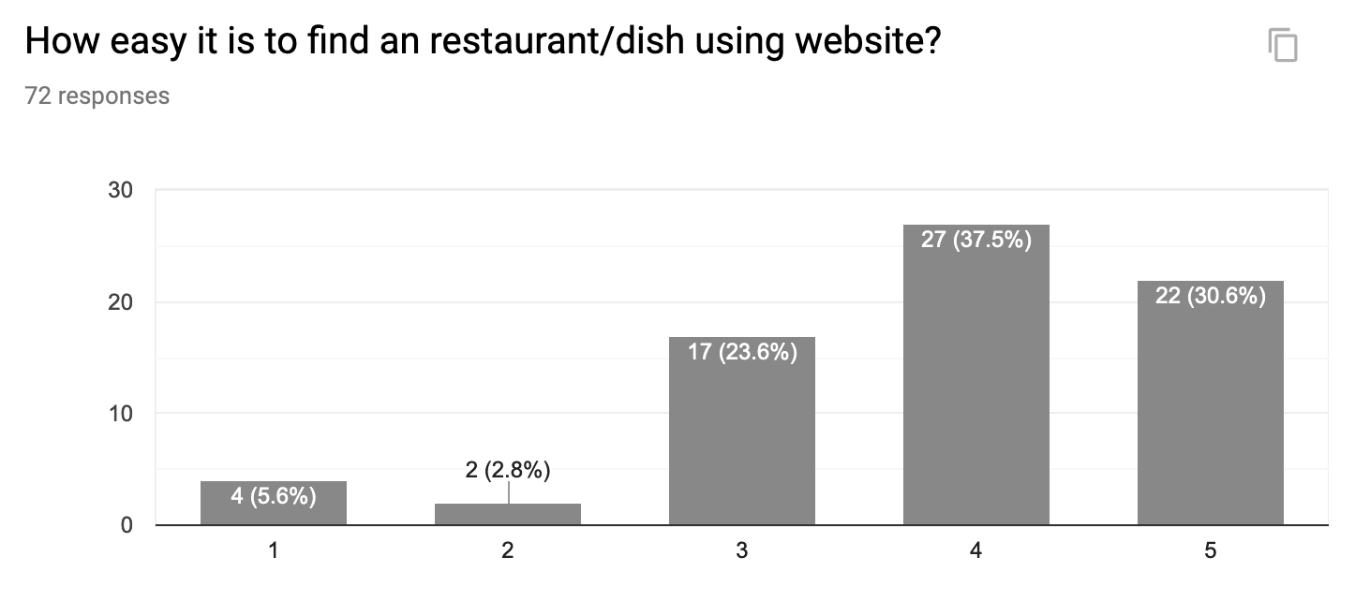
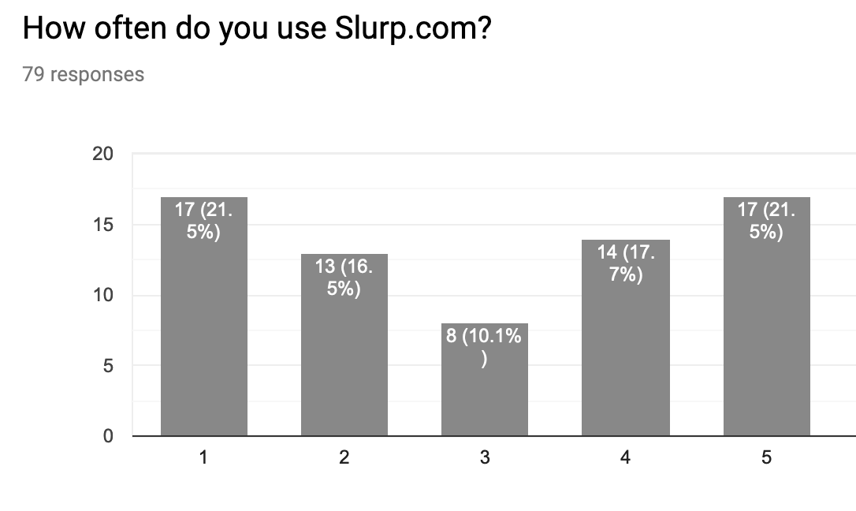
SURVEY results

Slide 29
User Feedback
User wanted a ‘search’ option in the blogs section
Make ‘deal’ option more prominent
User requested the option to mark restaurants as ‘Favorite’
‘Support’ option could have a better visibility
User wanted to have a detailed info on the ‘busy hours’ of the restaurants
User requested for better search filters like ‘tags’

Slide 30
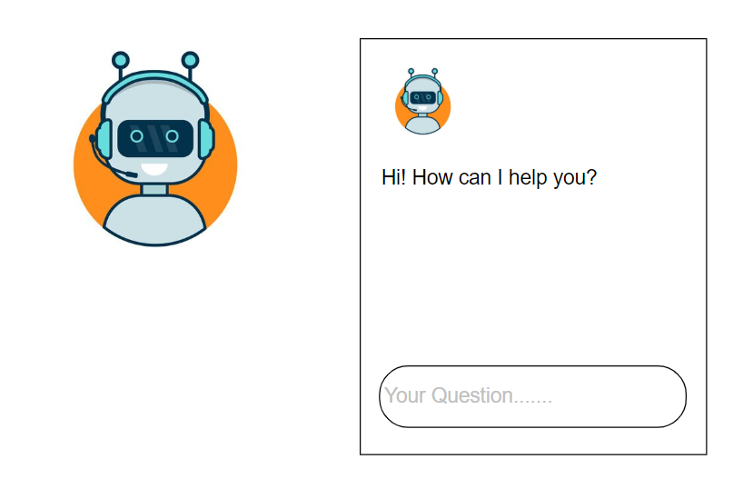
Human-Computer Interaction
In case of any queries, the customer can use the live chatbots to get help from customer care executives.
For instance if a customer care executive asks for the location of the user , he automatically gets a option to share the location.
Such a interaction saves the user from the trouble of clicking 3-4 times

Slide 31
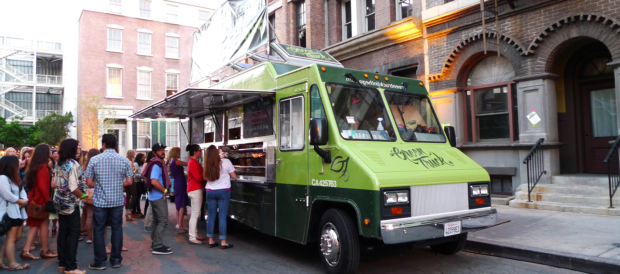
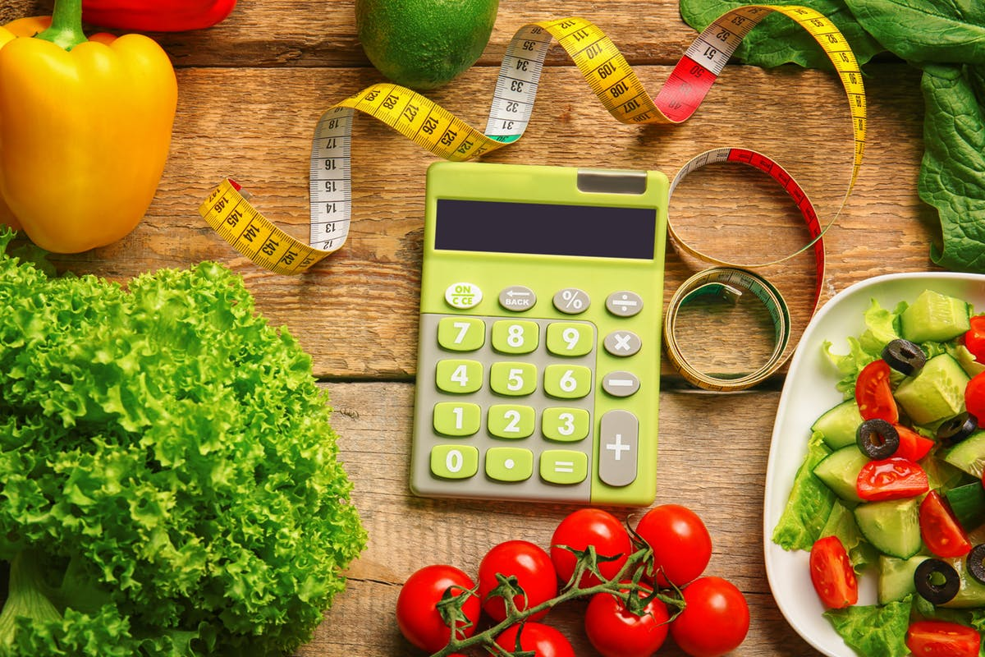
Moonshots
Food Truck with GPS enabled - By knowing precisely where their favorite food truck is located and at exactly what time it will arrive at the designated destination.
Counts the food calories as you order the items to the cart

Slide 32
Reflections
Best Features
Reserve Table
Food Truck
Points that took hard work
User Feedback
Survey
Future works
Live Tracking of Food Truck
Counting Calories of food served
Mobile App

Slide 33
DEMO

Slide 34
QA Testing – Selenium

Slide 35
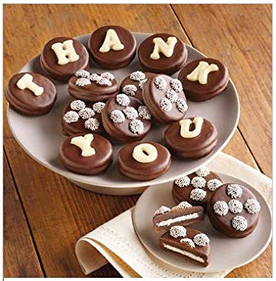
Thank you!

